Slide 1




Disclosure Guidelines for Children and Adolescents in the context of HIV, TB and non-communicable diseases
Provincial Dissemination Workshop

Slide 2
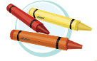

Getting to Know Each Other
Instructions:
On the piece of paper provided, make a clear outline of your hand.
On each of your fingers, write down five things about yourself that someone else would not know, e.g. “My favourite sweet is…”, or, “For fun, I like to…”
Then, share your work with the person on your right, who will be your partner.
Introduce your partner to the larger group, stating one fact about them that was shared.

Slide 3
Chapter 1: Definitions and Guiding Principles
Definitions of Children and Adolescents
Newborns | Birth - 28 days
Infants | 28 days – 1 year
Toddlers | 1 – 3 years
Early Childhood Middle Childhood | 3 – 5 years
 | 6 – 9 years
Early Adolescence Late Adolescence | 10 – 14 years
 | 15 – 19 years

Slide 4

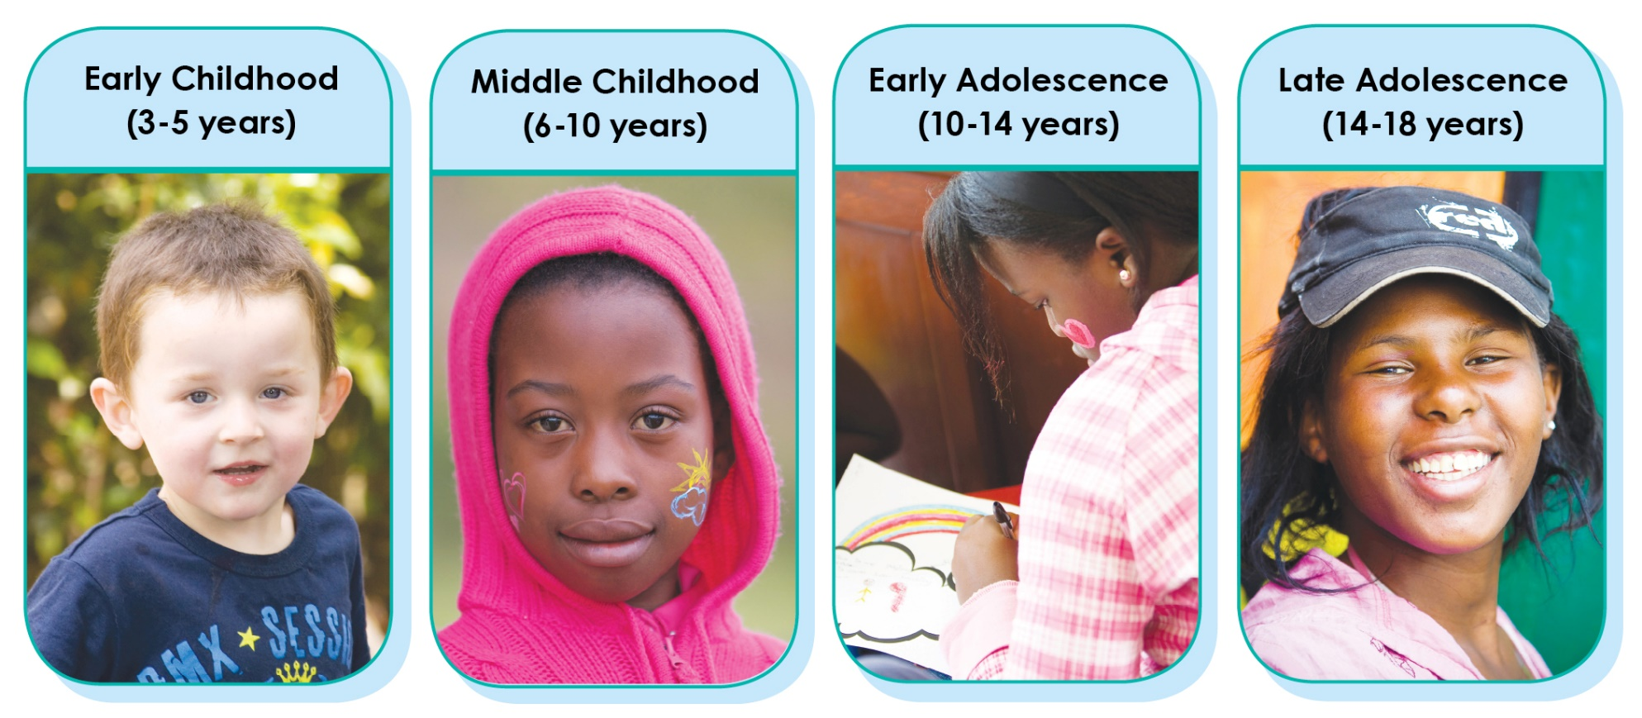
Chapter 1: Definitions and Guiding Principles
Early Childhood
(3 – 5 years)
Middle Childhood
(6 – 9 years)
Early Adolescence
(10 – 14 years)
Late Adolescence
(15 – 19 years)

Slide 5
Chapter 1: Disclosure Guiding Principles
Definitions
Health | Health is a state of complete physical, mental and social well-being and not merely the absence of disease or infirmity (WHO definition, 1946).
Family | These are the face-to-face interactions within the family group, mainly between a C&A and PCG. There is more than one picture of what a family looks like - it is the quality of the relationships and interactions that are important.
Primary Caregiver | The parent, legal guardian or person responsible for providing primary care to the C&A.

Slide 6
Chapter 1: Disclosure Guiding Principles
Definitions cont.
Health Care Provider | Any trained HCP providing disclosure services within facility or community (nurse, doctor, counsellor, social worker or psychologist).
Child & Adolescent Disclosure | A process whereby a child gains knowledge of his/her HIV status or his/her caregiver’s HIV status. A gradual process of giving children age-appropriate information regarding their illness, leading to full disclosure when the child has the cognitive and emotional maturity to process this information.

Slide 7
Chapter 1: Disclosure Guiding Principles
Levels of Disclosure
Non-Disclosure | The child is unaware of their illness and its effect on their body
Partial Disclosure | The child is made aware of their illness without actually naming HIV
Full Disclosure | The child is made aware of their illness which is named as HIV

Slide 8
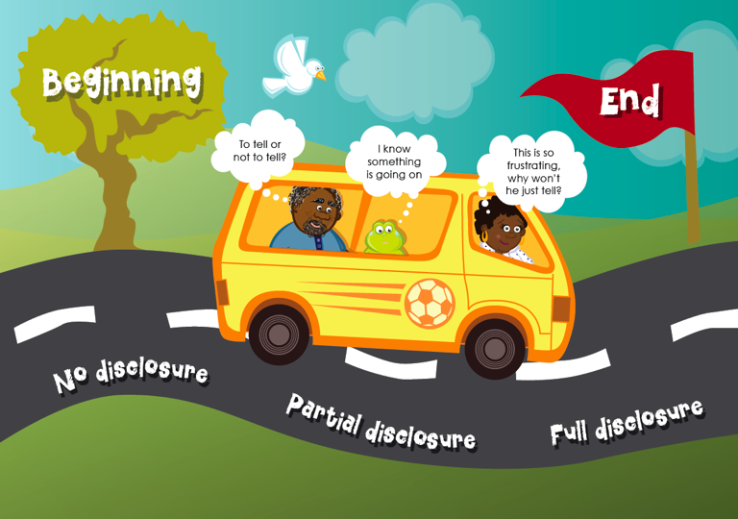
0 – 2 years
3 – 9 years
10 + years
Notes:
Another key area around our strategy is making all parties involved in this process understand that it is not a once off event.
Looking at this picture, one can see that disclosing a child’s HIV status to them is a journey. It is a journey on a long road that the counselor, caregiver and child go on together.
This journey has a beginning or starting point and an end or destination.
Along this road, in between the beginning and the end, it can be seen as the process of disclosure that takes place, which may start at the beginning with no disclosure, to the middle with partial disclosure, to the end with full disclosure.
The way that the caregiver and child get from the beginning to the end is dependable on the mode of transport, a vehicle which is the counseling process that is driven by the counselor themselves.
Along this road you are traveling, you will have to deal with a caregiver who is busy moving through the different stages of the Behaviour Change Model as they contemplate disclosure to their child.

Slide 9
Chapter 1: Disclosure Guiding Principles
Types of Disclosure
Prepared Disclosure | The HCP, the PCG and the child are fully prepared for the disclosure process
Unprepared Disclosure | Either the health care provider, the primary caregiver or the child are not fully prepared for the disclosure process
Involuntary Disclosure | The primary caregiver is forced into disclosing to the child due to circumstances
Health Promoting Disclosure | The child knows everything about their disease that is appropriate for their age. They are equipped in a supportive manner with skills to take age-appropriate responsibility for their health
Accidental Disclosure | The child becomes aware of their illness purely through an incident that is accidental
Complete Disclosure Process | The child is guided through a process, from the stage of non-disclosure to the stage of health-promoting disclosure within a children’s rights framework

Slide 10
Chapter 1: Disclosure Guiding Principles
Complexity of Disclosure
Uncomplicated Disclosure | “Typical” transmission e.g. Perinatal, or consensual sexual activity for adolescents Not abusive or illegal No current or recent trauma No current or recent crisis Supportive environment
Complex Disclosure | “Atypical” transmission Abusive or illegal Recent or current trauma Current crisis Non-supportive environment Pathological bereavements Child-headed household Vulnerability of caregiver Disability

Slide 11







Chapter 1: Disclosure Guiding Principles
Optimal Disclosure
Disclosure that is prepared, health-promoting, age-appropriate, takes place within a supportive and enabling environment and is handled according to the complexity of the situation.
Prepared
Health Promoting
Optimal Disclosure
Supportive and
Enabling Environment
Handled Appropriately
According to Complexity
Age Appropriate

Slide 12
Chapter 2: Legal and Ethical Framework
HIV Testing, Children and the Law
In small groups, brainstorm the concepts related to testing a child for HIV and compliance with the relevant laws. Record these responses to share with the larger group.
Discuss if any group members have ever faced any challenges when testing a child for HIV (in relation to these laws). Record these responses and select a person from your group to share with the larger group.

Slide 13
Chapter 2: Legal and Ethical Framework
What is required to test a child according to the law?
Child
Best interest of the child
Pre and Post Counselling
Consent
  Voluntary
  Informed
Capacity
Caregiver
Confidentiality

Slide 14

Chapter 2: Legal and Ethical Framework
Types of children who should be tested for HIV.
According to the National Policy on HIV Counselling and testing:
An HIV exposed infant
An abandoned baby
An infant younger than 18 months
A breast-fed baby of an HIV positive mother
An abused child
A street child
A child over the age of 18 months
A child must be 12 years or older to consent independently to an HIV test.

Slide 15
Chapter 2: Legal and Ethical Framework
Concept of “best interest”
This is a legal concept that requires decision makers to consider what is “best” for an individual child.
What effect will the decision have on the child (Physically, emotionally, spiritually etc.)?
What is the child’s age?
In what stages of development is the child?
What is the child’s gender?
What is the child’s socio- economic and cultural context?
What is the level of the child’s intellectual, social and cultural development?

Slide 16
Chapter 2: Legal and Ethical Framework
What is the level of the child’s physical and emotional security?
Does the child suffer from any disability or chronic illness?
Will this decision place the child in any physical or psychological danger?
What impact will this decision have on the child’s physical health?

Slide 17


Chapter 2: Legal and Ethical Framework
Concepts of counselling and testing:
As it is a priority in counselling an adult, a child needs to receive proficient counselling that is age-appropriate.
It must be a voluntary and informed agreement by a person who has the capacity to make this choice.
Be able to give written and verbal consent.
It must not involve threatening, coercion or include force.
It must not induce fear.

Slide 18

Chapter 2: Legal and Ethical Framework
Relates to whether child shows sufficient maturity to understand the benefits , risks and social implications of the test.
The children’s Act assumes that a child can give consent to HIV test from age of 12.
Child over the age of 12 does not appear to have capacity if:
  The child is unable to grasp the key concepts
  The child is intoxicated or under influence of drugs
  The child is unable to act independently in making a choice.

Slide 19

Chapter 2: Legal and Ethical Framework
A foster parent
A person caring for a child as a parent or a guardian
A person caring for a child in temporary safe care
The person heading a child/youth care center
The head of the shelter
A youth care worker caring for the child without appropriate care in the community
A child who heads a child-headed household
A designated child protection organization (person in charge)

Slide 20

Chapter 2: Legal and Ethical Framework
According to the Children’s Act:
You may not disclose a child’s status without proper consent, unless the child is being tested because there is suspicion that a healthcare worker may have contracted HIV through contact with the child.

Slide 21
Chapter 2: Legal and Ethical Framework
To whom can confidential information be disclosed to?
The child (if older than 12 years)
A child who is younger than 12, but showing sufficient maturity
A parent or caregiver
A designated child protection organization, if the child is to be placed into a ‘place of safety’
The superintendent of a hospital, if none of the above is involved
Members of the multidisciplinary team working with the child
A child who is younger than 12 but showing sufficient maturity
A parent, caregiver or designated child protection organization in placing the child into a place of safety.
The superintendent of a hospital if none of the above is involved.

Slide 22
Chapter 2: Legal and Ethical Framework
What is confidential information:
  The HIV test results
  The child’s information discovered during the counselling process
  In the case of a caregiver or the third party who refuses to disclose to the child, and the health care provider feels that it is in the best interest of the child, you may apply for consent to override the decision from the Department of Social Development.

Slide 23
Chapter 2: Legal and Ethical Framework
Disclosure and the rights of the child
In your smaller groups, using your crayons, draw a picture of a child onto the flipchart paper you have been provided. You can choose a girl or boy, of any age between 4 and 11 years old. Give your child a name, and write her/his age next to the drawing.
Next, discuss what your group thinks are the rights of the child, that you should uphold, when we are working with a caregiver around disclosure to their child. What do you think the rights of the child are? And how can you explain these rights to the caregiver? Draw/write these rights around the picture of your child.
Select a different person from your group to introduce your child and their rights to the bigger group.

Slide 24
Chapter 2: Legal and Ethical Framework
Children’s rights in the context of HIV
Children's right are clearly indicated in:
United Nations convention on the Rights of the Children
African Children’s charter
South African Constitution
Children’s Act

Slide 25
Chapter 2: Legal and Ethical Framework
An Ethical Framework for Disclosure – use a stepped systematic approach to ethical decision making:
1
Identify the conflicting ethical issue
2
Identify all role players affected by decision
3
Identify consequences of decision to all role players
4
5
6
7
Explore possible options and outcomes
Consult with multi-disciplinary team
Make the decision and document the process
Monitor and evaluate the decision

Slide 26
Chapter 3: A Contextual Framework for Disclosure
What is successful disclosure?
Intentional and not accidental
Timely – starting from 3 years of age
Truthful
Family centred
Prepared:
  Primary Caregiver
  Skilled HCP
  Child and/or Adolescent
Age/Developmentally appropriate
Linked to support

Slide 27
Chapter 3: A Contextual Framework for Disclosure
Role Players in Disclosure
Using the diagram below, brainstorm the various role players in disclosure
National
Facility
Family
Individual
Community

Slide 28
Chapter 3: A Contextual Framework for Disclosure
Disclosure Case Studies
1. In your groups, complete the following:
Read through the case study handout
Address the specific task for the case study
Record the challenges that the case study presents around disclosure
Explain your disclosure plan
2. For feedback to the larger group:
Present a case history of the case study
Explain the challenges of the case study as identified by your team
Describe your preferred approach with regard to disclosure and what your group feels is the most appropriate disclosure plan
Select a representative to feedback to the larger group

Slide 29
Chapter 3: A Contextual Framework for Disclosure
Barriers to Disclosure
In small groups discuss the barriers each role player could experience in disclosure to a child or adolescent
Select one member of the group to give feedback to the larger group
Barriers to disclosure
PCG
Health Facility
HCP

Slide 30





Chapter 4: Holistic Model for Disclosure
Process of Disclosure
Follow up date
Multidisciplinary team Ongoing assessment
Next disclosure task Support groups
Prepare a space
Documentation
Tools HCP
PCG
Support
and Follow Up
Step 1
C&A
Step 4
Preparation
and Planning
Disclosure and Health Promoting
Tasks
Step 2
Assessment and Disclosure Plan
Age appropriate
C&AFS
Tasks to match the session Linkages and follow up dates
Step 3
C&A – Emotions, developmental stage, support
PCG – Type of disclosure – complex or simple
Support networks

Slide 31
Chapter 4: Holistic Model for Disclosure
Health Facility
HCP
PCG and Family
Child/ Adolescent
Step 1: Preparation and Planning
Key role players involved step 1

Slide 32
Chapter 4: Holistic Model for Disclosure
Step 1: Preparation and Planning
1. Health Facility
Policies, guidelines and related documents
  In place
  Staff trained and working within the framework
Health facility structures
  Child-friendly space: confidential and safe
Adapting service delivery
  Flexible service times
  Active case-finding strategies
Community services linked to facility

Slide 33
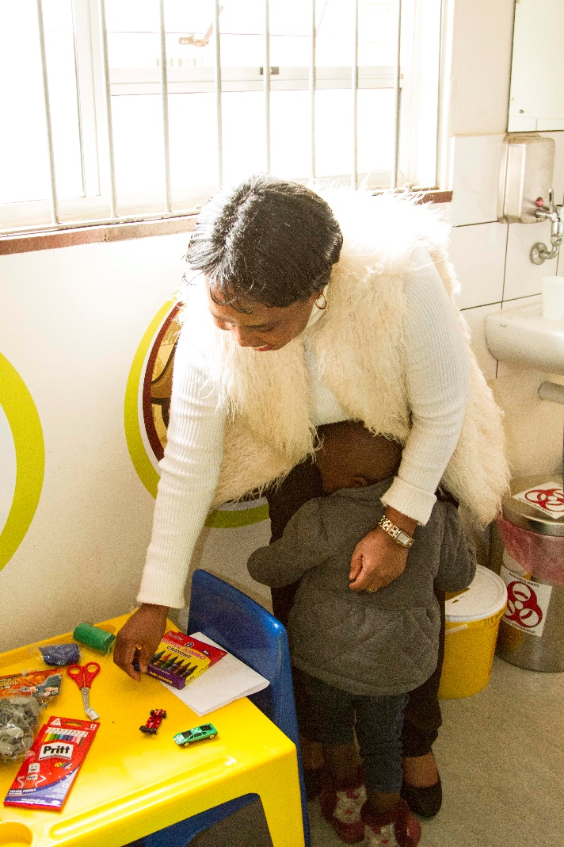
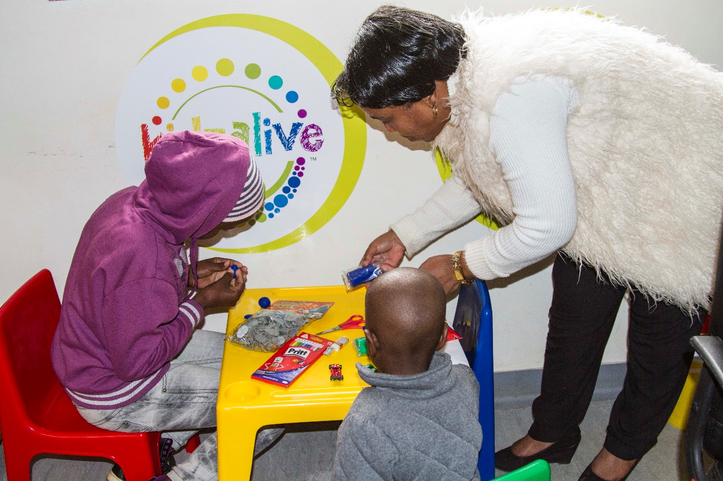
Child-Friendly Spaces

Slide 34
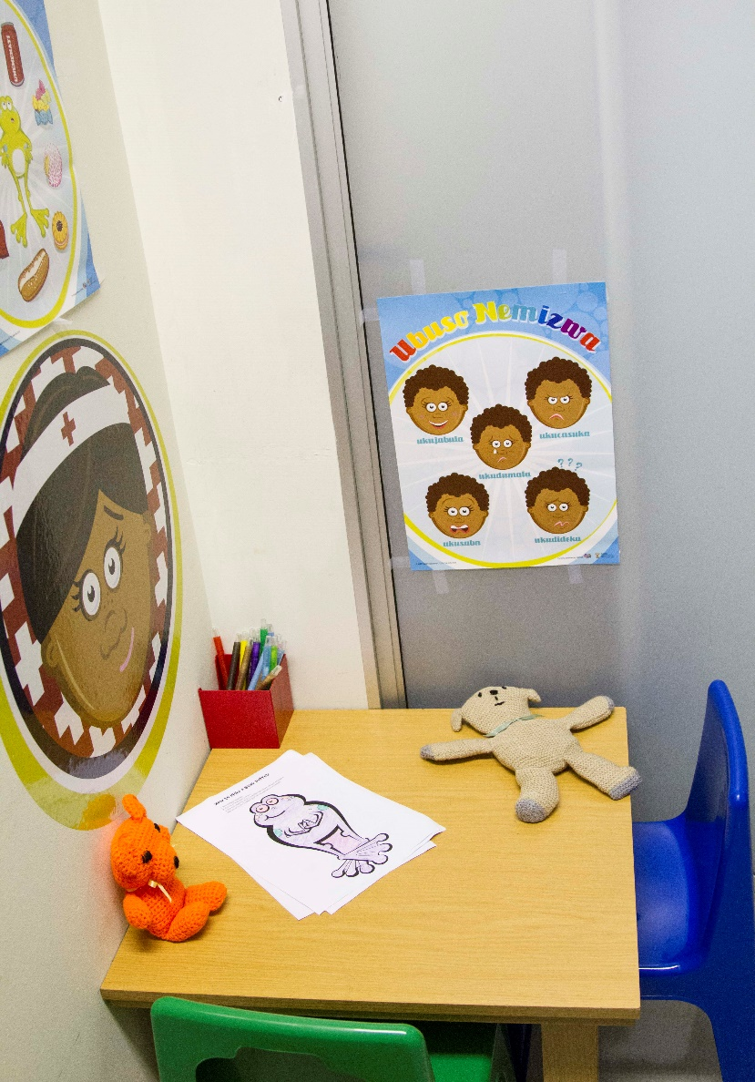
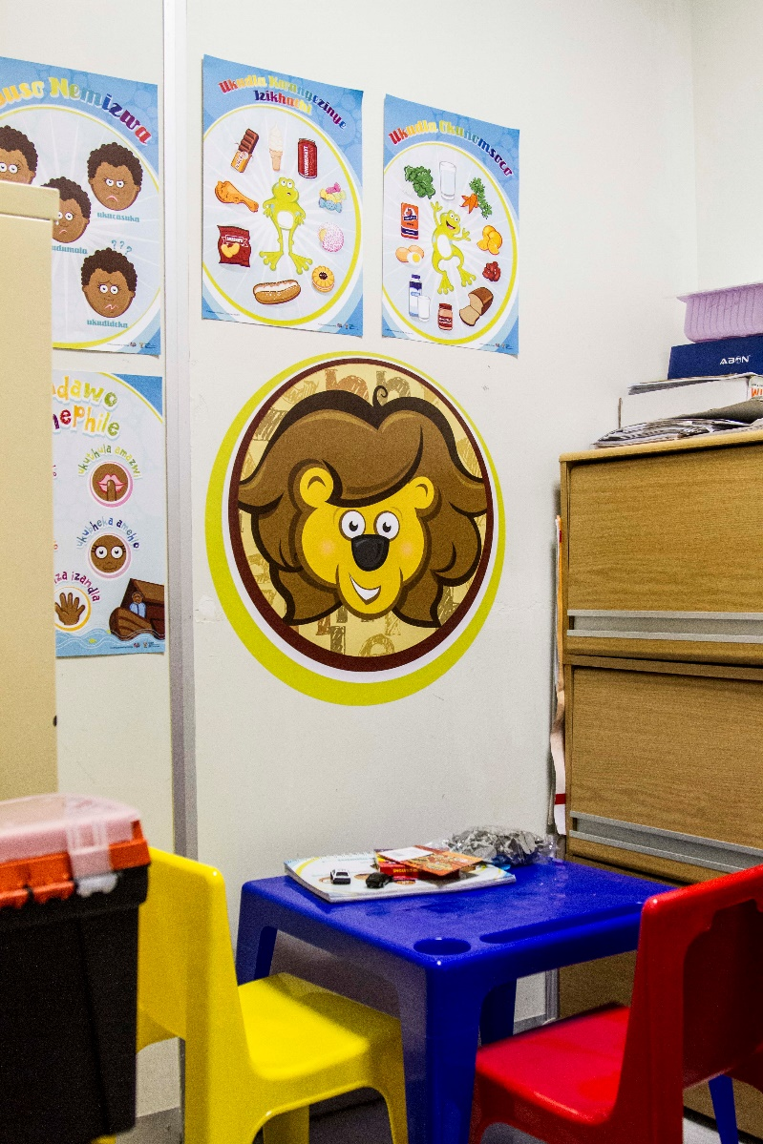
Child-Friendly Spaces

Slide 35
Chapter 4: Holistic Model for Disclosure
Step 1: Preparation and Planning
2. Health Care Provider
Six key tasks for HCPs in the disclosure process:
Case finding
  Undiagnosed C&A living with HIV
  C&A with no or incomplete disclosure
Counselling PCGs on the benefits of disclosure
Preparing PCGs for disclosure
Facilitating the process of disclosure together with PCGs
Ensuring legal aspects of disclosure are adhered to
Facilitating ongoing linkages and support

Slide 36
Chapter 4: Holistic Model for Disclosure
Key components HCPs need to deliver disclosure services
Training
Disclosure process
Support
Fears and concerns
Unresolved emotional issues
Tools
Age appropriate tools and resources
Other related topics e.g. sex, sexuality
Age appropriate language for children
Disclosure tools for recording

Slide 37
Chapter 4: Holistic Model for Disclosure
Disclosure should be done by the PCG with support from the HCP
Step 1: Preparation and Planning
3. Primary Care Giver and Family
Disclosure should be done by the PCG with support from the HCP
PCGs need:
  Unforced disclosure until ready
  Support to deal with their own HIV status
Education about HIV and its psychosocial impacts so
Confidence to answer questions about HIV/AIDS to their children
To understand the development of C&A so that can use age appropriate language
Confidence about the process of disclosure
Knowledge and skills for the ongoing disclosure process
Linkages to support services within the government sector and community to ensure ongoing social, psychological and economical support (for example, social grants)

Slide 38
Chapter 4: Holistic Model for Disclosure
Step 1: Preparation and Planning
Family Support Intervention (FSI)
Assessing the current knowledge and beliefs about disclosure
Assisting the PCG to process their own HIV status, grief, anger, guilt and shame
Sharing the advantages and disadvantages of disclosure, with the aim to promote disclosure to be part of long-term health and psychological benefit
Developing a plan to disclose to the C&A that deals with the fears of self disclosure, child disclosure and community disclosure, including plans to mitigate the risks of accidental community disclosure
Preparing wording and tools with the PCG to facilitate a caregiver-led process wherever possible

Slide 39
Chapter 4: Holistic Model for Disclosure
Step 1: Preparation and Planning
4. Child and Adolescent
Ensuring that the system within the facility is supportive and C&A-friendly
Ensuring that the C&AFS is ready
PCGs can assist by not letting the C&A notice their anxiety
PCGs can bring a snack to the facility so that the C&A is not distracted by hungry
HCPs need to be friendly to create a relaxed environment

Slide 40
Chapter 4: Holistic Model for Disclosure
Step 2: Pre-Disclosure Assessment & Disclosure Plan
Insight into Family Circumstances
Uncomplicated or
Complex (Refer)
Development Levels of Child
Pre-Disclosure Assessment
This discussion should NEVER be conducted in front of the child or adolescent

Slide 41
Chapter 4: Holistic Model for Disclosure
Step 2: Pre-Disclosure Assessment & Disclosure Plan
A child is NEVER “not ready” for some level of disclosure

Slide 42
Chapter 4: Holistic Model for Disclosure
The Hand-of-Safety

Slide 43


Chapter 4: Holistic Model for Disclosure
The Hand-of-Safety
Break into smaller groups. Choose one person to role play the child, the caregiver and the healthcare provider
The healthcare provider should help the child to create their own hand of safety
Demonstrate how the caregiver is included in the process and that the tool is used as a negotiating tool to determine who the child can trust

Slide 44
Chapter 4: Holistic Model for Disclosure
Step 3: Disclosure sessions and developing health-promoting tasks
Ensure privacy and a C&A-friendly environment
Keep child busy with an activity, engage the PCG to ensure that the plan is still the same
Engage with the C&A appropriately
Once the C&A is comfortable and relaxed, use the tools provided to discuss the health of the child, using age-appropriate terminologies.
Allow the child to ask questions and answer as truthfully as possible, using pictures and tools to ensure that the child understands
Allow the child to express emotions appropriately

Slide 45
Chapter 4: Holistic Model for Disclosure
Age-appropriate Health-Promoting Tasks: Childhood

Slide 46
Chapter 4: Holistic Model for Disclosure
Age-appropriate Health-Promoting Tasks: Adolescence

Slide 47
Chapter 4: Holistic Model for Disclosure
Step 4: Follow up and support
Schedule regular follow-up sessions to build the relationship and allow more time
Always document sessions
Ensure that the C&A is enrolled and remains in a support group where possible
Where issues arise, discuss these with the multidisciplinary team

Slide 48
Chapter 5: Disclosure in the context of a child
Core Counselling Skills in Children
Core skill | Definition
Play and fun | Children talk using the language of PLAY, rather than the language of words. Using play, and ensuring that the child has fun, as a method of counselling the child are KEY. Laugh with the child. Make appropriate physical contact – touching the arm or hand.
Observation | Observation during play will enable the HCP to pick up the non-verbal messages that the child is sharing during play. This is similar to active listening, except that we are listening to the child by picking up clues through play, drawing and creativity.
Active listening | Using a set of skills to encourage the child to talk and make them feel heard and understood. Called ‘active’ because the HCP engages intentionally to help the child feel comfortable to talk as well as is attentive to what the child is saying, how they are acting and how they feel.
Questioning | The HCP’s ability to probe or question effectively is key to effective counselling. HCP should use open ended questions and closed questions appropriately, based on the information needed. HCP can use drawing, play or puppets to ask questions and receive answers so that the child does not feel intimidated.
Silence | Silence in a session should be recognised as acceptable. The child may need time to process and understand things. Allow them the time.

Slide 49
Chapter 5: Disclosure in the context of a child
Talking to 3 – 5 year olds
Age 3 – 5 years
Tools to use: | Talk about:
Use stories to talk to the child Puppets work well Use concrete examples | Going to the clinic to keep your body well “Do you know that there are things that we can do to keep our bodies health?” Sometimes foods (unhealthy/treats) and everyday foods (healthy – should be eaten every day) Keeping active – sport or playing outside Drinking water Germs that can be in our bodies to make us sick: Dizzy Diarrhoea, Vallerie the Vomiting Germ (see the Talk Tool) Taking our medicine – use concrete examples, like “the medicine will put the germ to sleep”

Slide 50
Chapter 5: Disclosure in the context of a child
Talking to 6 - 9 year olds
Age 6 – 9 years
Tools to use: | Talk about:
Use drawings and playing with figures You can start to use less concrete examples More detail can be given about the illness | A germ that lives in the body that can make you sick Soldier cells – that help to keep our bodies strong Begin to name some of the germs – TB, meningitis, “Your medicine will help to fight the germs” Explain how some diseases are healed and some stay with us. Goodnight medicines (put virus to bed) and goodbye medicines (cure disease)

Slide 51
Chapter 6: Disclosure in the context of an adolescent
Core Counselling Skills in Adolescents
Core skill | Definition
Active listening | Using a set of skills to encourage the adolescent to talk and make them feel heard and understood. Called “active” because the HCP does things intentionally to help the client feel able to talk, and because there is engagement with all attention on what the adolescent is saying, how they are acting and how they feel.
Questioning | The HCP’s ability to probe or question effectively is key to effective counselling. HCP should use open ended questions and closed questions appropriately, based on the information needed.
Paraphrasing | Simply restating the adolescent’s message in your own words to check that you have understood what they have said.
Clarification | Regularly checking to see that you have understood what the adolescent is saying and feeling.
Reflecting | Requires the HCP to mirror the adolescent’s feelings.
Summarising | Similar to paraphrasing but covers a longer time span and more information.

Slide 52
Chapter 6: Disclosure in the context of an adolescent
Talking to 10 – 12 year olds
Age 10 – 12 years
Tools to use: | Talk about:
Use books Hand-of-Safety – inside and outside stories Begin to use more complex terminologies | The germ that is called HIV CD4 cells, immune system Explore sexual development Focus on sexual transmission of HIV

Slide 53
Chapter 6: Disclosure in the context of an adolescent
Talking to 12 – 18 year olds
Age 12 – 18 years
Tools to use: | Talk about:
Journaling Adherence tools Circles of support | HIV and sexual transmission Risky behaviours Delaying sexual interaction Lower-risk sexual practices Peer pressure influences Sexual reproductive health

Slide 54
Roleplaying Chapters 5 & 6
Activity
Divide into pairs. One person will role play the child and the other the healthcare provider
Practice the language used for the various age groups providing HIV Disclosure Counselling
Change roles for the age group so that each participant has an opportunity to be the healthcare provider

Slide 55
Chapter 7: Integrating Disclosure
Case Finding
Caregiver Engagement
Disclosure to the Child and Adolescent
There are 3 strategies that complete the disclosure process, as outlined below

Slide 56
Chapter 7: Integrating Disclosure
Activity on Strategy 1: Active Case Finding
Divide into small groups
Brainstorm around how you could actively find HIV exposed children and adolescents at:
  Community Level
  Facility Level
Record your responses on flipchart paper and select a representative to feedback to the larger group

Slide 57
Chapter 7: Integrating Disclosure
Activity on Strategy 2 & 3: Caregiver Engagement and Disclosure
Divide into small groups
Brainstorm around the barriers that caregivers may face and how they can overcome these barriers:
  When deciding to test their children for HIV
  When deciding to disclosure to their children
Record your responses on flipchart paper and select a representative to feedback to the larger group

Slide 58

Questions

